Slide 1
AI-DRIVEN BEHAVIORAL DATA ANALYTICS FOR MENTAL HEALTH
PREDICTING USER TRENDS AND PROVIDING ACTIONABLE INSIGHTS
TERM PAPER

Slide 2
TEAM MEMBERS
NAME | ID NO
Nedulla Vighnesh | 2200032267
Nallapati Yallaiah | 2200031880
Vasupalli Shanmukha | 2200031784
Vighnesh Kumar | 2200030570
BATCH NO:-57

Slide 3
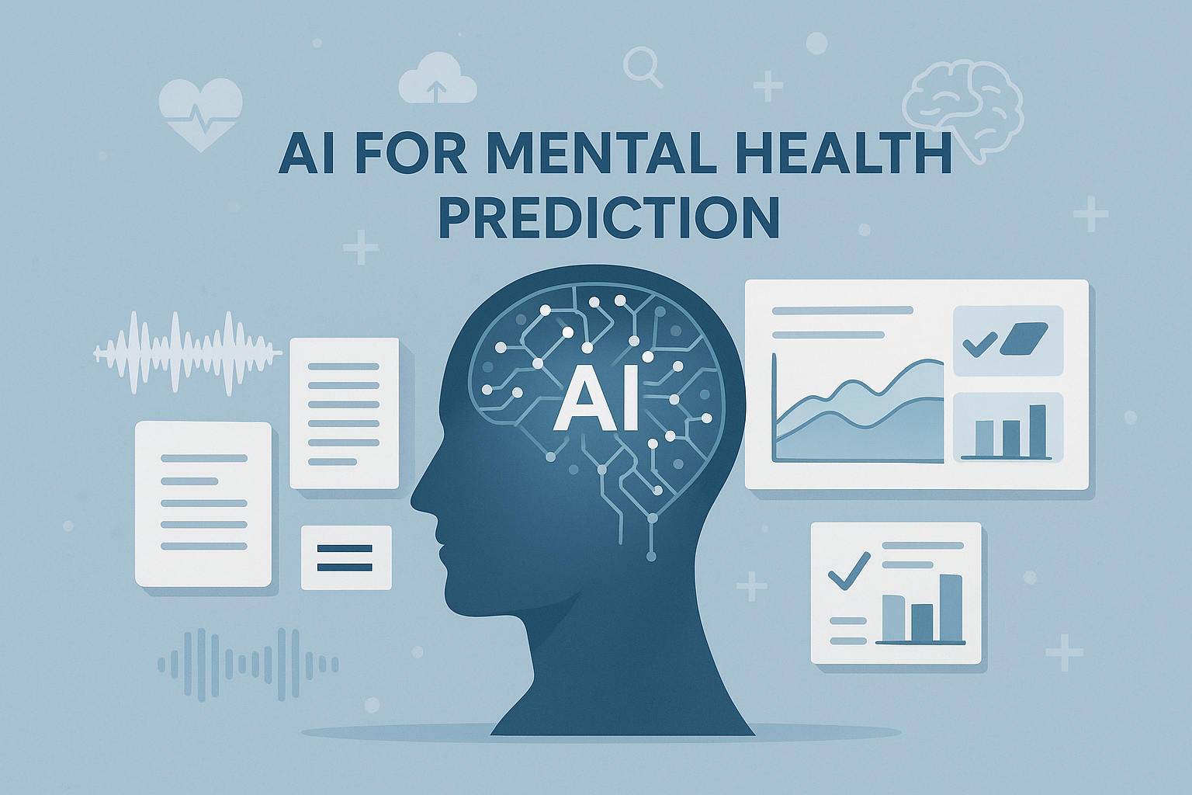
INTRODUCTION
Mental health disorders are rapidly increasing worldwide, often going undiagnosed due to limited clinical resources and subjective assessments. There is a growing need for scalable, intelligent diagnostic tools.
This project introduces a multimodal AI-based framework that uses techniques like natural language processing, speech and emotion analysis, and behavioral pattern recognition to enhance early diagnosis and support therapeutic decisions.
By continuously analyzing user behavior across multiple data sources, the system aims to improve diagnostic accuracy, enable real-time monitoring, and deliver personalized mental health insights—redefining how mental healthcare is approached.

Slide 4
ABSTRACT
This project presents an AI-driven behavioral data analytics system designed to support mental health diagnosis and therapy. By leveraging multimodal data sources—such as text input, speech patterns, and digital interaction data—the system uses machine learning and deep learning models to detect early signs of mental health conditions like anxiety, depression, and stress.
The framework focuses on analyzing subtle behavioral trends to provide predictive insights, allowing therapists and caregivers to plan effective, personalized interventions. It emphasizes real-time monitoring, privacy-preserving data handling, and compliance with healthcare standards including ISO/TS 82304-1 and GDPR.
By combining artificial intelligence with behavioral psychology, the project aims to improve mental health outcomes, enhance clinical decision-making, and empower users through proactive self-awareness and care.

Slide 5
PROBLEM STATEMENT
Mental health disorders are often underdiagnosed or misdiagnosed due to:
Limited access to clinical professionals, especially in remote areas
Subjective and inconsistent assessment methods
Lack of real-time monitoring of behavioral changes
Delayed interventions, which can worsen conditions over time
There is a critical need for a scalable, intelligent system that can continuously analyze behavioral data and provide early, accurate insights to support mental health diagnosis and therapy.

Slide 6
PROJECT OBJECTIVES
Early Detection - Identify mental health risks by analyzing behavioral data such as text, voice, and app usage.
Predictive Trend Analysis
- Track user behavior over time to detect patterns linked to mental health conditions.
Personalized Insights - Generate tailored recommendations to support users, therapists, and caregivers.
Real-Time Monitoring - Enable continuous observation for timely interventions.
Data Privacy and Standards Compliance - Ensure secure and ethical use of user data in line with ISO/TS 82304-1, GDPR, and HIPAA.
KEY FEATURES
Multimodal input analysis (text, voice, app usage)
Machine learning-based mental health trend prediction
Personalized alerts and insights

Slide 7
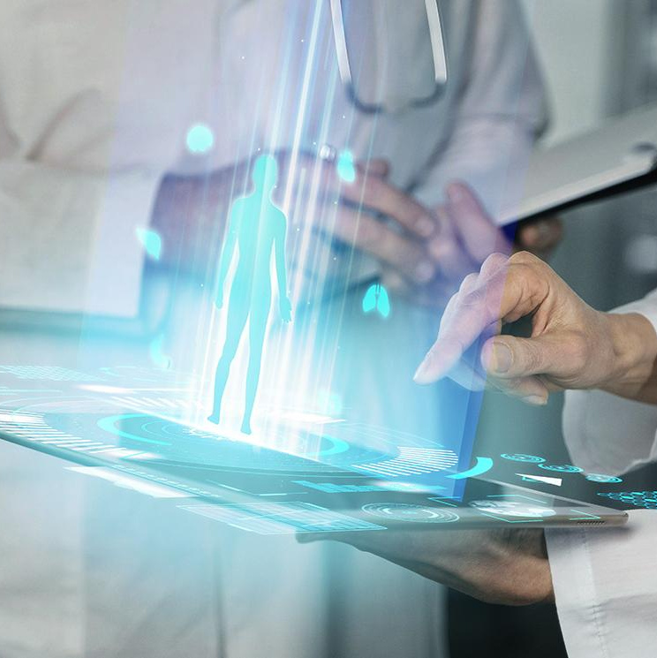
DATA SOURCES
Text Data: Analyzed from user-generated content such as messages, social media posts, and online interactions.
Voice Data: Captured from speech patterns during conversations or voice-based input, analyzed for emotional tone and stress indicators.
Behavioral Data: Collected from app usage patterns, screen time, and interaction frequency to assess mental well-being.
ISO/TS 82304-1 for user data protection.

Slide 8
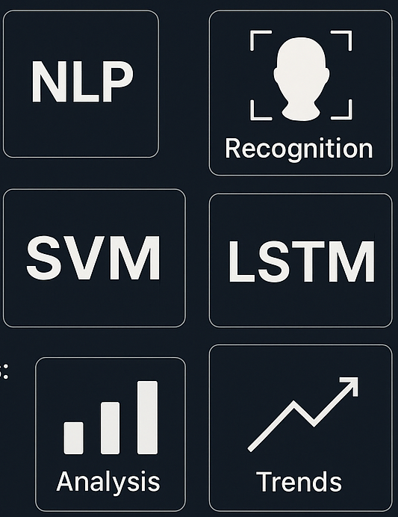
TECHNOLOGIES USED
Data Collection & Processing:
NLP Tools (for text analysis): SpaCy, NLTK
Speech Emotion Recognition: OpenSMILE, DeepSBD
Data Preprocessing: Pandas, NumPy, Scikit-learn
Data Privacy Tools: Encryption libraries, secure data storage
Machine Learning & Deep Learning Models:
SVM, Random Forest, Logistic Regression (for classification)
LSTM (for trend prediction)
TensorFlow, Keras, PyTorch (for model development)
Visualization & Dashboard:
Matplotlib, Plotly (for graphs and trend analysis)

Slide 9
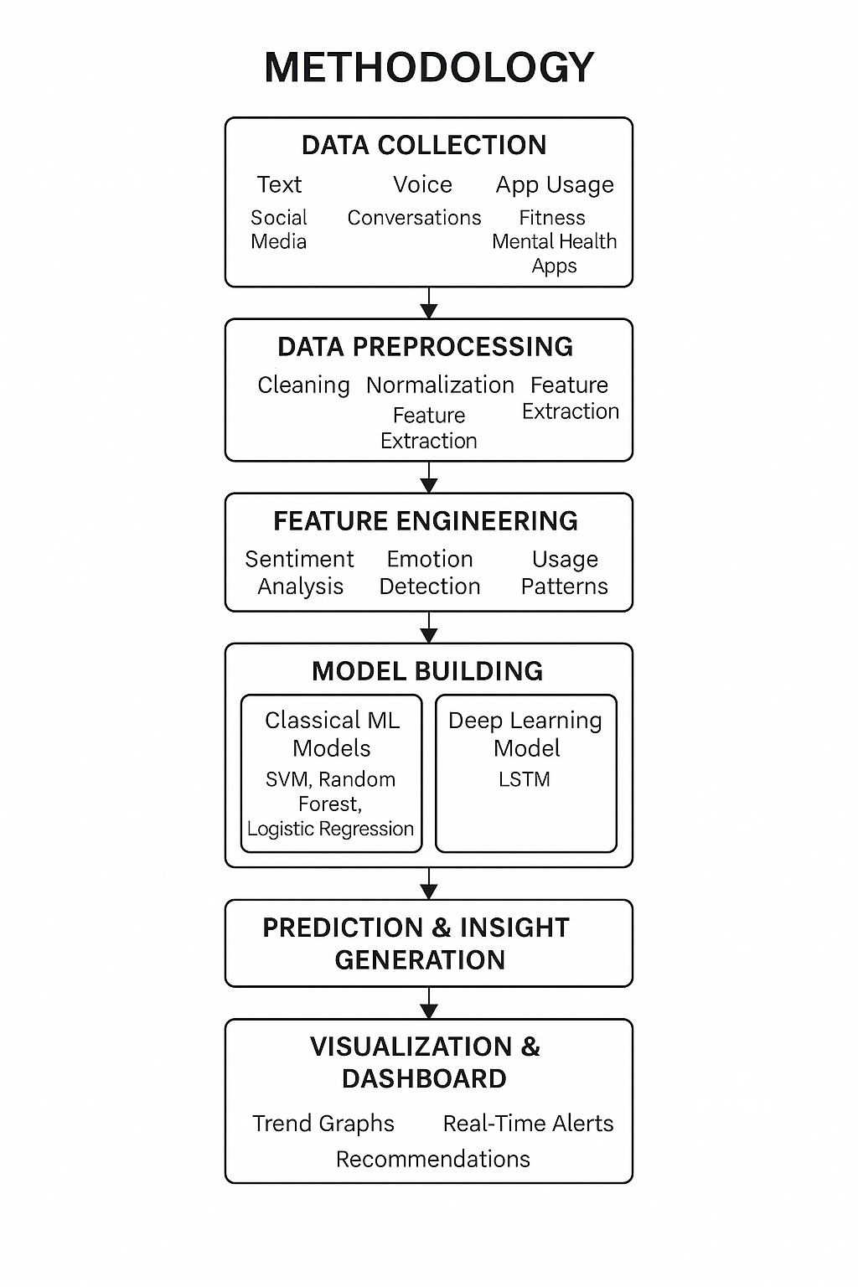
METHODOLOGY
Data Collection
Collect anonymized user behavioral data (text, voice, app usage).
Ensure data privacy compliance (GDPR, HIPAA).
Preprocessing
Text Data: Clean, tokenize, and normalize text for sentiment analysis.
Voice Data: Extract Mel-frequency cepstral coefficients (MFCC) for emotion recognition.
App Usage Data: Normalize and format interaction data.
Feature Engineering
Extract sentiment scores from text data using NLP techniques.
Tag emotions in speech using emotion recognition models.
Identify usage patterns from app data to track mental health trends.
Model Building
Classification Models:
SVM (Support Vector Machine), Random Forest, and Logistic Regression for detecting mental health conditions.
Deep Learning Models:
Use LSTM (Long Short-Term Memory) networks to predict temporal trends and changes in mental health over time.
Prediction & Insight Generation
Use trained models to predict mental health conditions and generate personalized insights.

Slide 10
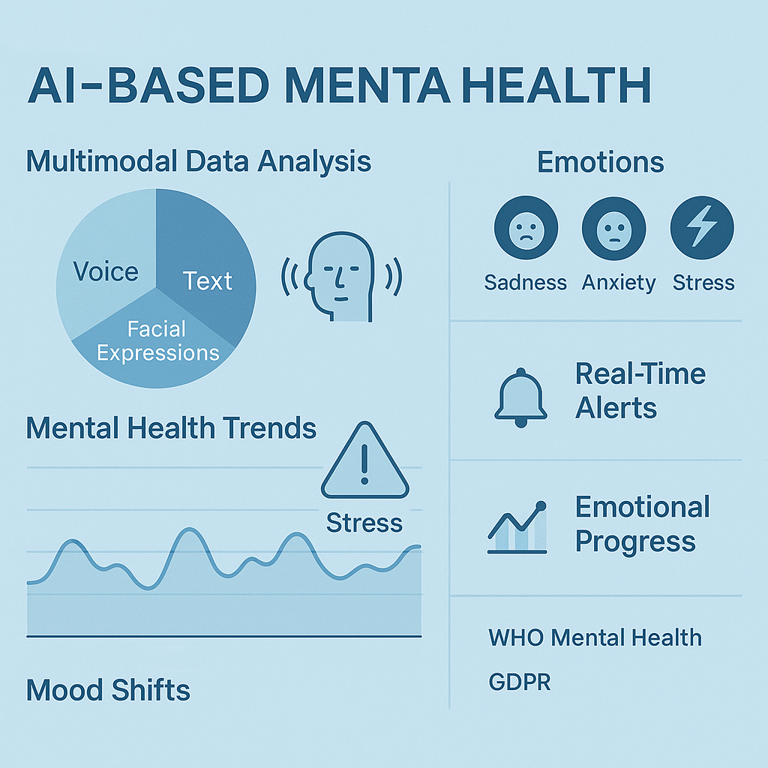
RESULTS AND INSIGHTS
BEHAVIORAL INSIGHTS
Emotional Pattern Recognition:
Detected anxiety patterns based on speech data, including fluctuations in tone, speech speed.
Identified depression trends through patterns of app usage .
Usage Patterns:
Identified a significant reduction in app interactions for users exhibiting depressive symptoms,
aiding early detection.
Stress Indicators:
High correlation between speech stress levels and increased emotional distress
as identified by the model.
PERSONALIZED RECOMMENDATIONS
Mental Health Support:
Provided real-time alerts based on behavioral changes, prompting users to engage in therapeutic activities.
Behavioral Adjustments:
Personalized recommendations for stress management, such as meditation or exercise suggestions.
VISUALIZATIONS & INSIGHTS
Dashboard :
Displayed user emotion trends, mental health scores, and real-time alerts in a user-friendly interface.
Trend Graphs:
Showed daily mental health trend graphs that predicted mood shifts and recommended appropriate actions.
REAL-WORLD IMPACT
Enhanced Diagnosis:
Provided healthcare professionals with additional tools for early detection of mental health conditions.
Continuous Monitoring:
Offered real-time monitoring of mental health changes for better therapy planning and intervention.

Slide 11
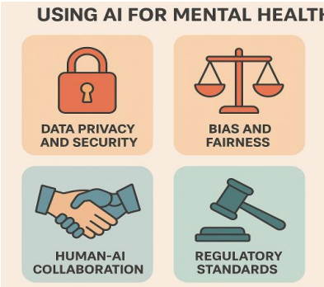
CHALLENGES FACED
Data Privacy & Security:
Ensuring compliance with privacy regulations such as GDPR and HIPAA
while processing sensitive user data.
Implementing robust encryption techniques to protect user data during
collection, storage, and transmission.
Data Quality:
Handling incomplete, noisy, or biased behavioral data, which impacted
the model’s accuracy and reliability.
Model Generalization:
Ensuring that the models generalize well to various users from different backgrounds, avoiding overfitting to the training data.
Real-Time Processing:
Achieving efficient real-time processing of large behavioral datasets while maintaining system performance and accuracy.

Slide 12
FUTURE WORK
Integration of More Data Modalities:
Incorporating data from wearables (e.g., heart rate, physical activity) to enhance prediction accuracy and behavioral trend detection.
Enhancement of Predictive Models:
Exploring more advanced deep learning architectures, such as transformers and reinforcement learning, for even better personalization and prediction accuracy.
Scalability:
Improving the system’s scalability to handle larger datasets and provide solutions for diverse user bases.
Collaboration with Mental Health Professionals:
Collaborating with mental health experts to further refine the system’s recommendations and decision-making process.

Slide 13
CONCLUSION
AI-Driven Behavioral Analytics:
The project successfully demonstrated the power of AI in monitoring and predicting mental health trends using behavioral data. It provides valuable insights for healthcare professionals and patients.
Real-World Impact:
The system has the potential to significantly enhance early detection, intervention, and treatment planning for mental health conditions.
Future Potential:
With the integration of additional data sources and more advanced models, the system can become a powerful tool in mental health diagnostics and continuous monitoring.

Slide 14


